Slide 1
CS5220 Advanced Topics in Web Programming
Spring – Aspect Oriented Programming
Chengyu Sun
California State University, Los Angeles

Slide 2
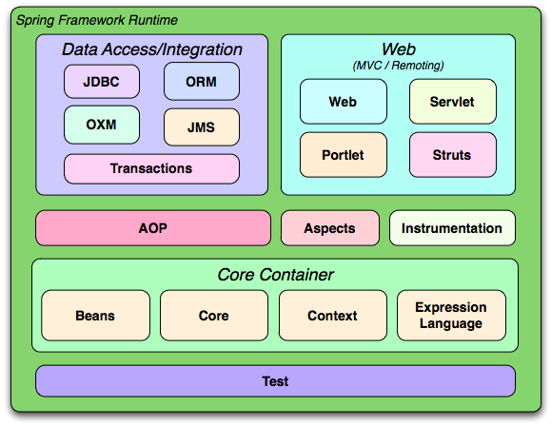
Spring Framework

Slide 3
Concerns
User
Management
Product
Management
Order
Management

Slide 4
Cross-Cutting Concerns
Logging
Transaction
Management
Security
User
Management
Product
Management
Order
Management

Slide 5
An Example of Transaction Rollback
catch( SQLException e ) {
System.err.println( e.getMessage() );
if( c != null ) {
try {
c.rollback();
} catch( SQLException ex ) {
System.err.println( ex.getMessage() );
}
}
}

Slide 6
Aspect Oriented Programming
Separate out cross-cutting concern code into their own classes or modules, called aspects.

Slide 7
Example: Logging
LoggedTask1 and LoggedTask2
  Both implement LoggedTask interface
  LoggedTask1 – mixes application code and logging code
  LoggedTask2 – only has application code

Slide 8
How Does it Work?
class Foo {
Object bar() {...}
}
run some code before bar() is called
run some code after bar() is called

Slide 9
Proxy – Subclass
class Foo1 extends Foo {
Object bar()
{
// some code before super.bar()
...
O o = super.bar();
// some code after super.bar();
...
return o;
}
}

Slide 10
Proxy – Wrapper Class
class Foo2 {
private Foo foo;
Object bar()
{
// some code before super.bar()
...
Object o = foo.bar();
// some code after super.bar();
...
return o;
}
}

Slide 11
Some AOP Terminology
Target
Proxy
Proxy Interface
Advice

Slide 12
Create Proxies Automatically -ProxyFactoryBean
<bean id="loggedTask2" class=“cs520.spring.aop.LoggedTask2" />
<bean id="loggedTask2WithAdvice"
class="org.springframework.aop.framework.ProxyFactoryBean">
<property name="proxyInterfaces">
<list>
<value>cs520.spring.log.LoggedTask</value>
</list>
</property>
<property name="target" ref="loggedTask2" />
<property name="interceptorNames">
<list>
<value>loggingAdvice</value>
</list>
</property>
</bean>

Slide 13
More AOP Terminology
Join point: a point in the execution of the application where the advice can be plugged in
Pointcut: A predicate that determines join points
Introduction: adding new methods and/or fields to existing classes
Weaving
  Compile time, class load time, or runtime

Slide 14
Spring AOP
Advices are written in Java
Pointcuts are defined in XML or annotation
Supports only method join points
Aspects are woven in at runtime
Advisor = Advice + Pointcuts

Slide 15
Advice Types
Type | Interface
Around | org.aopalliance.intercept.MethodInterceptor
Before | org.springframework.aop.MethodBeforeAdvice
After | org.springframework.aop.AfterReturningAdvice
Throws | org.springframework.aop.ThrowsAdvice

Slide 16
Use Interceptor
public class LoggingInterceptor implements MethodInterceptor {
public Object invoke( MethodInvocation invocation ) throws Throwable
{
// do something before method invocation
…
Object result = invocation.proceed();
// do something after method invocation
…
return result;
}
}

Slide 17
Configure Pointcuts
NameMatchMethodPointcutAdvisor
RegExpPointcutAdvisor
<bean id="loggingAdvisor“
class="org.springframework.aop.support.NameMatchMethodPointcutAdvisor">
<property name="mappedName" value="doSomething*" />
<property name="advice" ref="loggingInterceptor" />
</bean>

Slide 18
AOP Annotations
Spring Framework – Core
  Chapter 5. Aspect Oriented Programming with Spring

Slide 19
About AOP
Good??
Bad??

